Slide 1
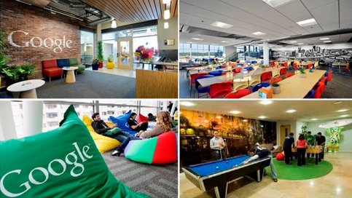
WORK CULTURE

Slide 2
Study contract
25% mid tes
35% final test
40% assignment

Slide 3
What is work culture?
Basic Definition of Work Culture is the personality of an Organization or simply “how things are done around organization/company/office
Work culture effects employee on their working hour, dresscode, office space,training and skills development, and interaction between other employees

Slide 4
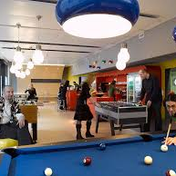
Is it work place ?
What’s your opinion?

Slide 5
Student’s activity
1. Find all the meaning from the following word or phrases: Organization/Co-Worker/Employee/hire/fire/Top companies / surprises / employee / satisfaction / salary / working conditions / survey / a different picture / career opportunities / proud / number one / focus / globe
2. Search on internet one of the most Top company and mention its work culture

